Slide 1
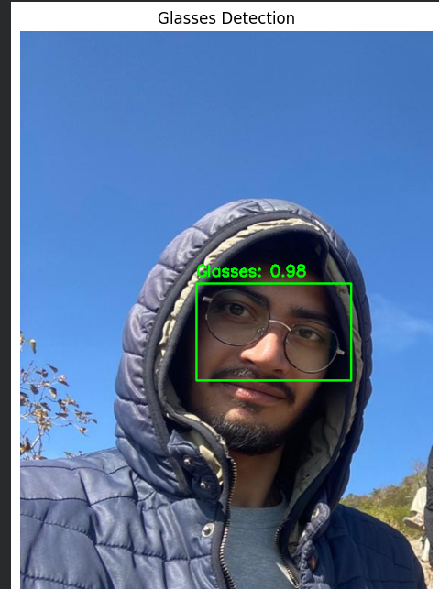

NEURAL NETWORKS PROJECT
Glasses Detection & Classification System
Using CNN and Faster R-CNN for real-time intelligent vision systems.
PRESENTED BY
COURSE
Wahab Ul Hassan
Neural Networks
42-FET/BSCE/F22

Slide 2



Smart Surveillance
Introduction Problem Statement
Enhanced monitoring and identification
Develop an intelligent computer vision system capable of analyzing facial features with precision and speed.
Face Analysis
Attribute extraction for HCI systems
Core Objectives
• Identify if a person is wearing glasses
• Detect location of glasses (Bounding Box)
• Perform Real-time analysis via webcam
Security & Access
Smart attendance and verification

Slide 3
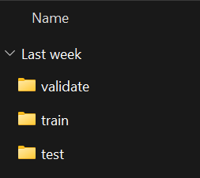
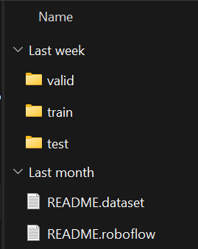
Datasets Used | Data Augmentation Pipeline
Classification Dataset
Detection Dataset
Original Size
Original Size
400
Images
500
Images
Augmentation Applied
Augmentation Applied
Rotation
Flip
Brightness
Zoom
Blur
Flip
Rotation
Brightness
Blur
Scaling
Final Size
Final Size
1000
Images
+150%
1000
Images
+100%

Slide 4


Classification
Classification vs Detection Approaches
Predicts only the class label. Determines if glasses are present.
Output: "Glasses" or "No Glasses"
Understanding the fundamental difference between identifying the presence of an object and pinpointing its location.
Core Difference
Detection
Classification answers "What?", while Detection answers "What and Where?".
Predicts class and location. Draws bounding boxes.
Output: "Glasses" + [x, y, w, h]

Slide 5
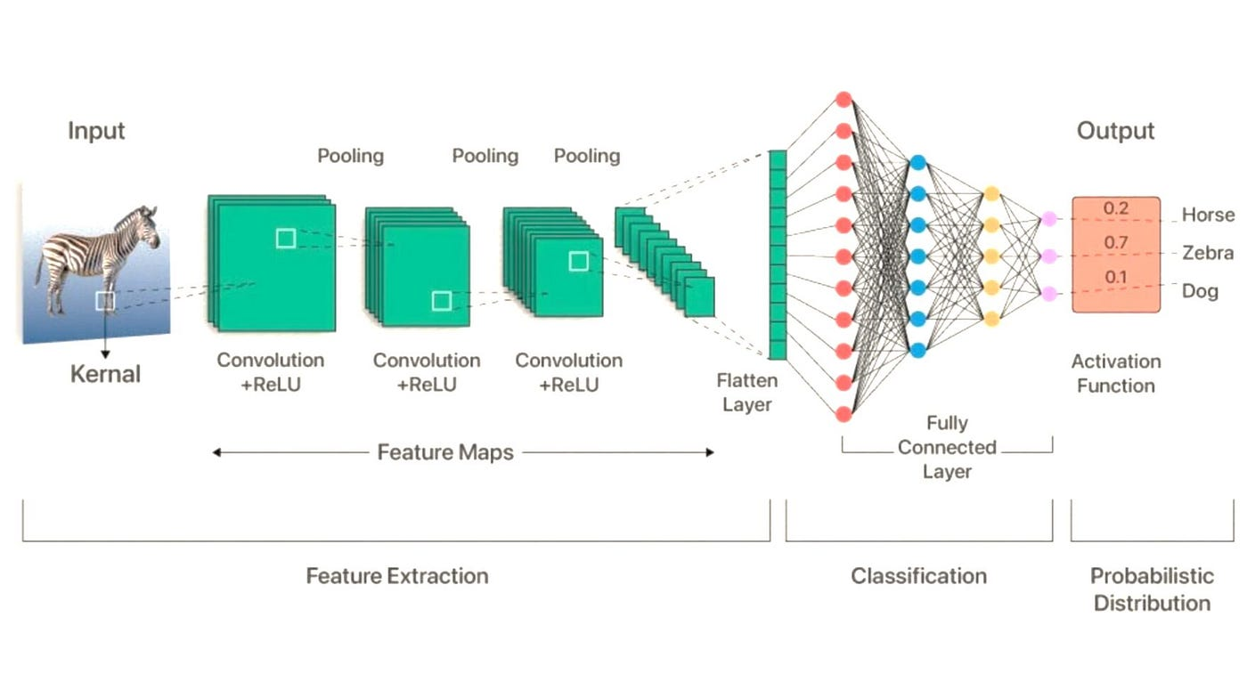




Convolutional Neural Networks | CNN Architecture
Architecture Flow
Key Advantages
Automatic Feature Extraction
Learns features directly from data without manual engineering
High Accuracy
State-of-the-art performance on image classification tasks
Efficient Processing
Parameter sharing and local connectivity reduce computation
Reduced Manual Work
Eliminates need for hand-crafted feature extractors
Input
Feature Maps
Compressed
Output
224x224x3
Conv+ReLU
Pooling
Class Score

Slide 6
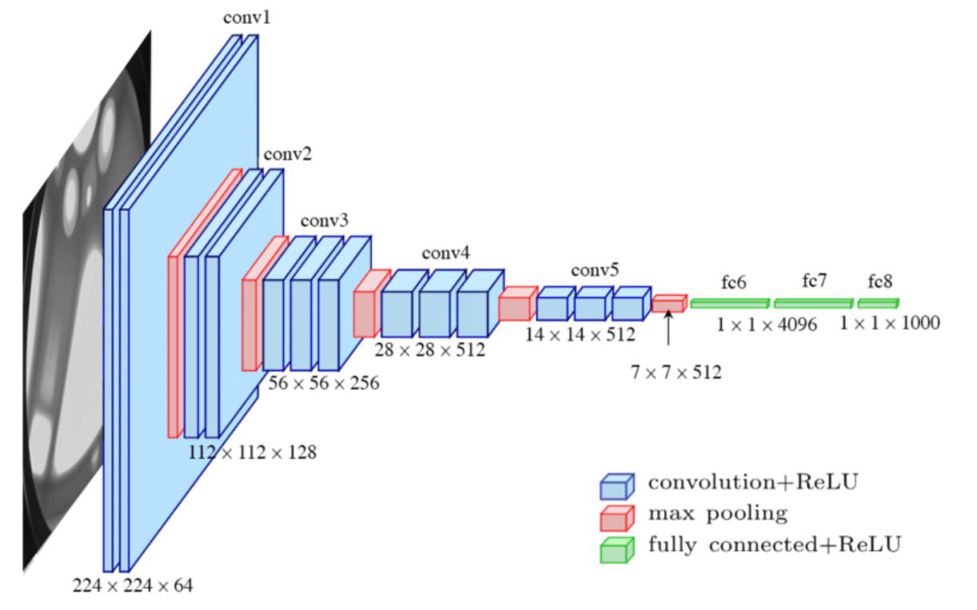




MobileNetV2 Architecture | Lightweight Classification
Architecture Structure
Key Features & Benefits
Inverted Residuals
Expand-then-project structure for efficient feature extraction
Lightweight Design
Depthwise separable convolutions reduce parameters significantly
Fast Training
Efficient architecture enables rapid model convergence
Mobile-Friendly
Optimized for mobile and embedded vision applications
Input
Expansion
Projection
Output
224x224x3
6x Channels
Linear
1280

Slide 7












Classification Training Process | Pipeline
01
02
03
04
Data Preparation
Preprocessing
Training
Evaluation
Original: 150 Images
Train / Val / Test Split
Model: MobileNetV2
Validation & Testing
Augmented: 1000 Images
Image Resizing (224x224)
Optimizer: Adam
Accuracy, Precision, Recall
Rotation, Flip, Zoom, Blur
Normalization (0-1 Range)
Loss: Binary Crossentropy
File: glasses_classifier.h5
DATA READY
PROCESSED
IN PROGRESS
COMPLETED

Slide 8
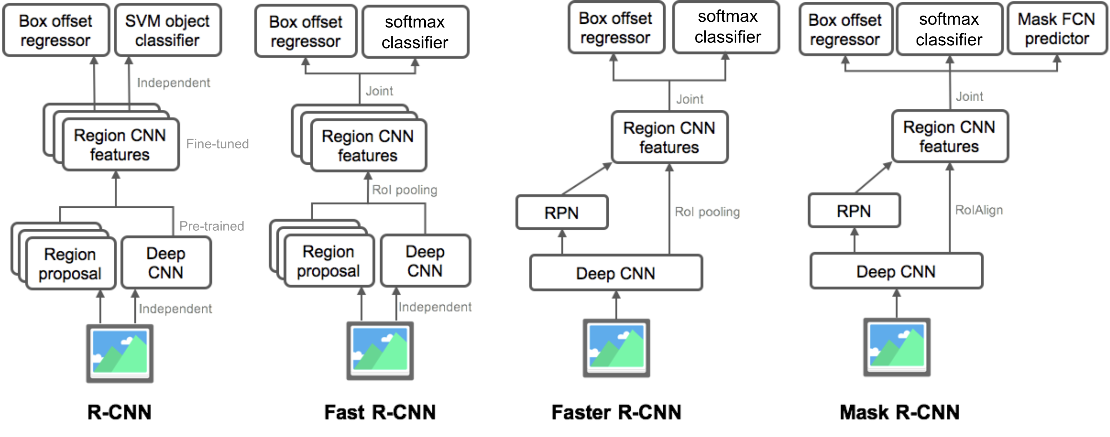



Faster R-CNN Detection Architecture | Two-Stage Detector
Architecture Flow
Key Components
ResNet50 Backbone
Deep feature extraction network for rich representations
Region Proposal Network
Generates object proposals directly from feature maps
ROI Pooling
Fixed-size feature extraction from variable regions
High Accuracy
Strong object localization and classification performance
Input
Backbone
RPN
Output
Image
ResNet50
Proposals
BBox+Class

Slide 9







Detection Training Process | Pipeline & Configuration
01
02
03
04
Data Preparation
Configuration
Training
Evaluation
Original: 203 Images
Framework: PyTorch
Optimizer: Adam
Precision & Recall
Augmented: 1000 Images
Model: Faster R-CNN
Learning Rate: 0.0001
IoU & mAP Metrics
Flip, Rotation, Brightness
Backbone: ResNet50
Epochs: 10
Model: faster_rcnn_glasses.pth
Batch Size: 2
DATA READY
CONFIGURED
TRAINING
COMPLETED

Slide 10
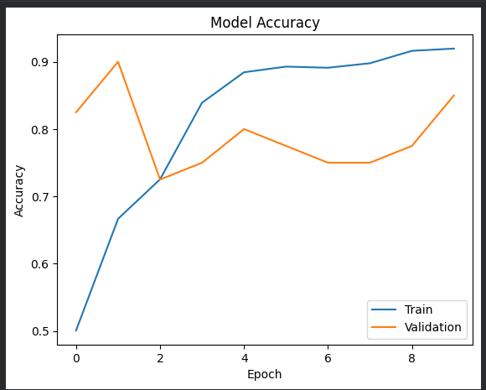
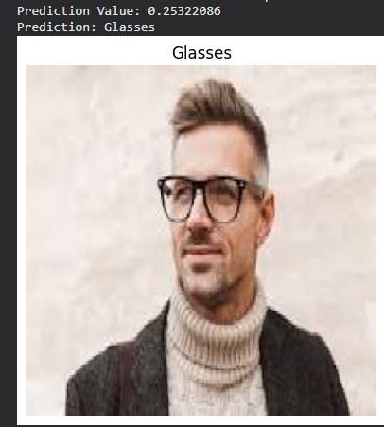
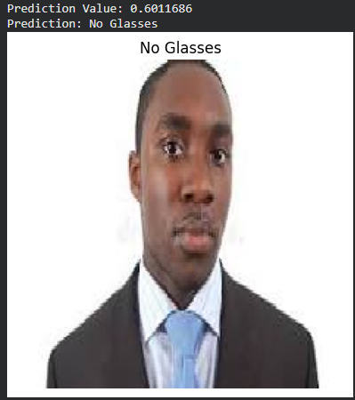
Classification Results | MobileNetV2 Performance
Prediction Examples
Model Accuracy
Prediction:
Glasses
Prediction:
No Glasses
Value: 0.253
Value: 0.0017
Training Accuracy
Validation Accuracy
0.92
0.85

Slide 11
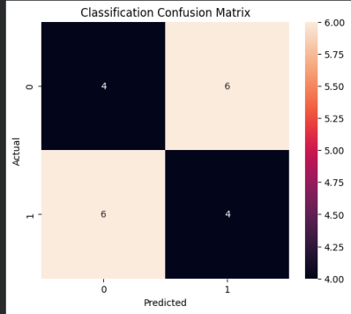
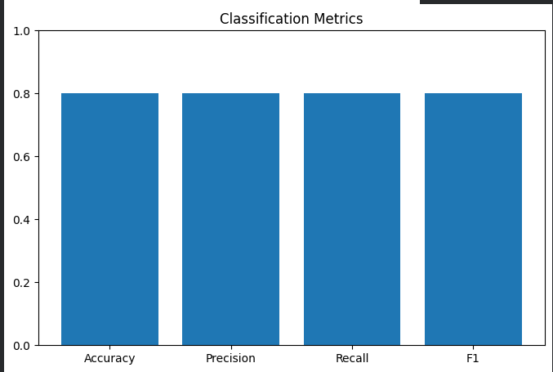
Classification Results | Performance Analysis
Classification Confusion Matrix
Classification Metrics
True Positives
True Negatives
Accuracy
Precision
Recall
F1 Score
4
4
0.80
0.80
0.80
0.80
False Positives
False Negatives
6
6

Slide 12
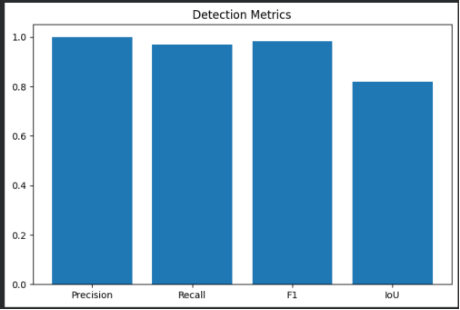
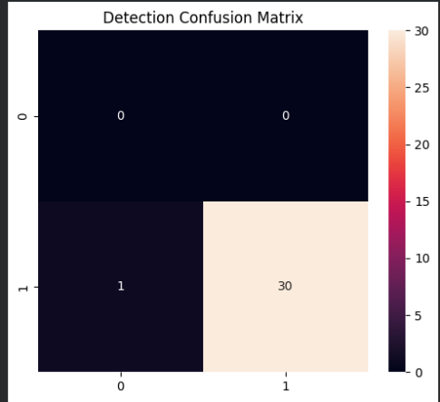
Detection Results | Faster R-CNN Performance
Detection Metrics
Detection Confusion Matrix
Precision
Recall
F1 Score
IoU
True Positives
True Negatives
1.00
1.00
1.00
0.80
30
0
False Positives
False Negatives
0
1

Slide 13
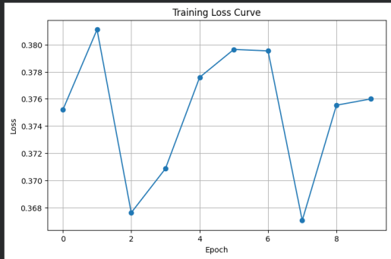
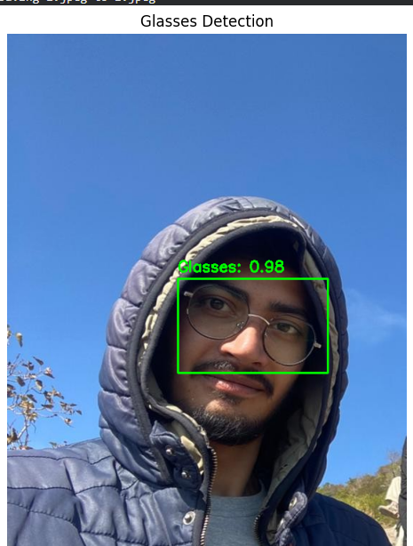
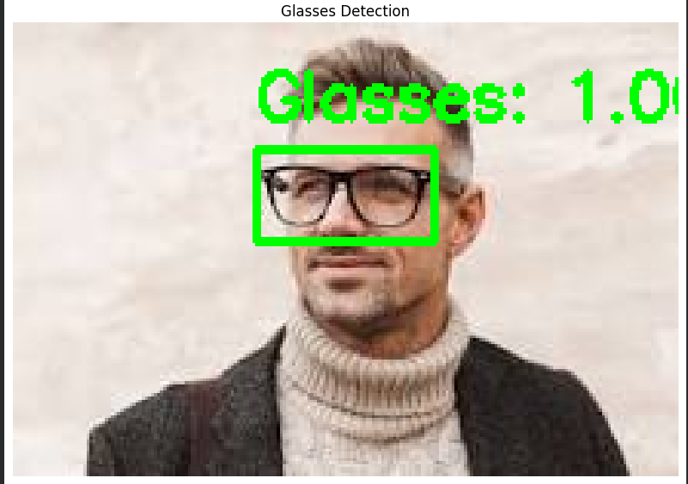


Detection Results | Training & Real-Time Performance
Training Loss Curve
Detection Example 1
Detection Example 2
Initial Loss
Final Loss
Detected Object
Detected Object
0.376
0.368
Glasses
Glasses
Confidence Score
Confidence Score
0.98
1.00

Slide 14
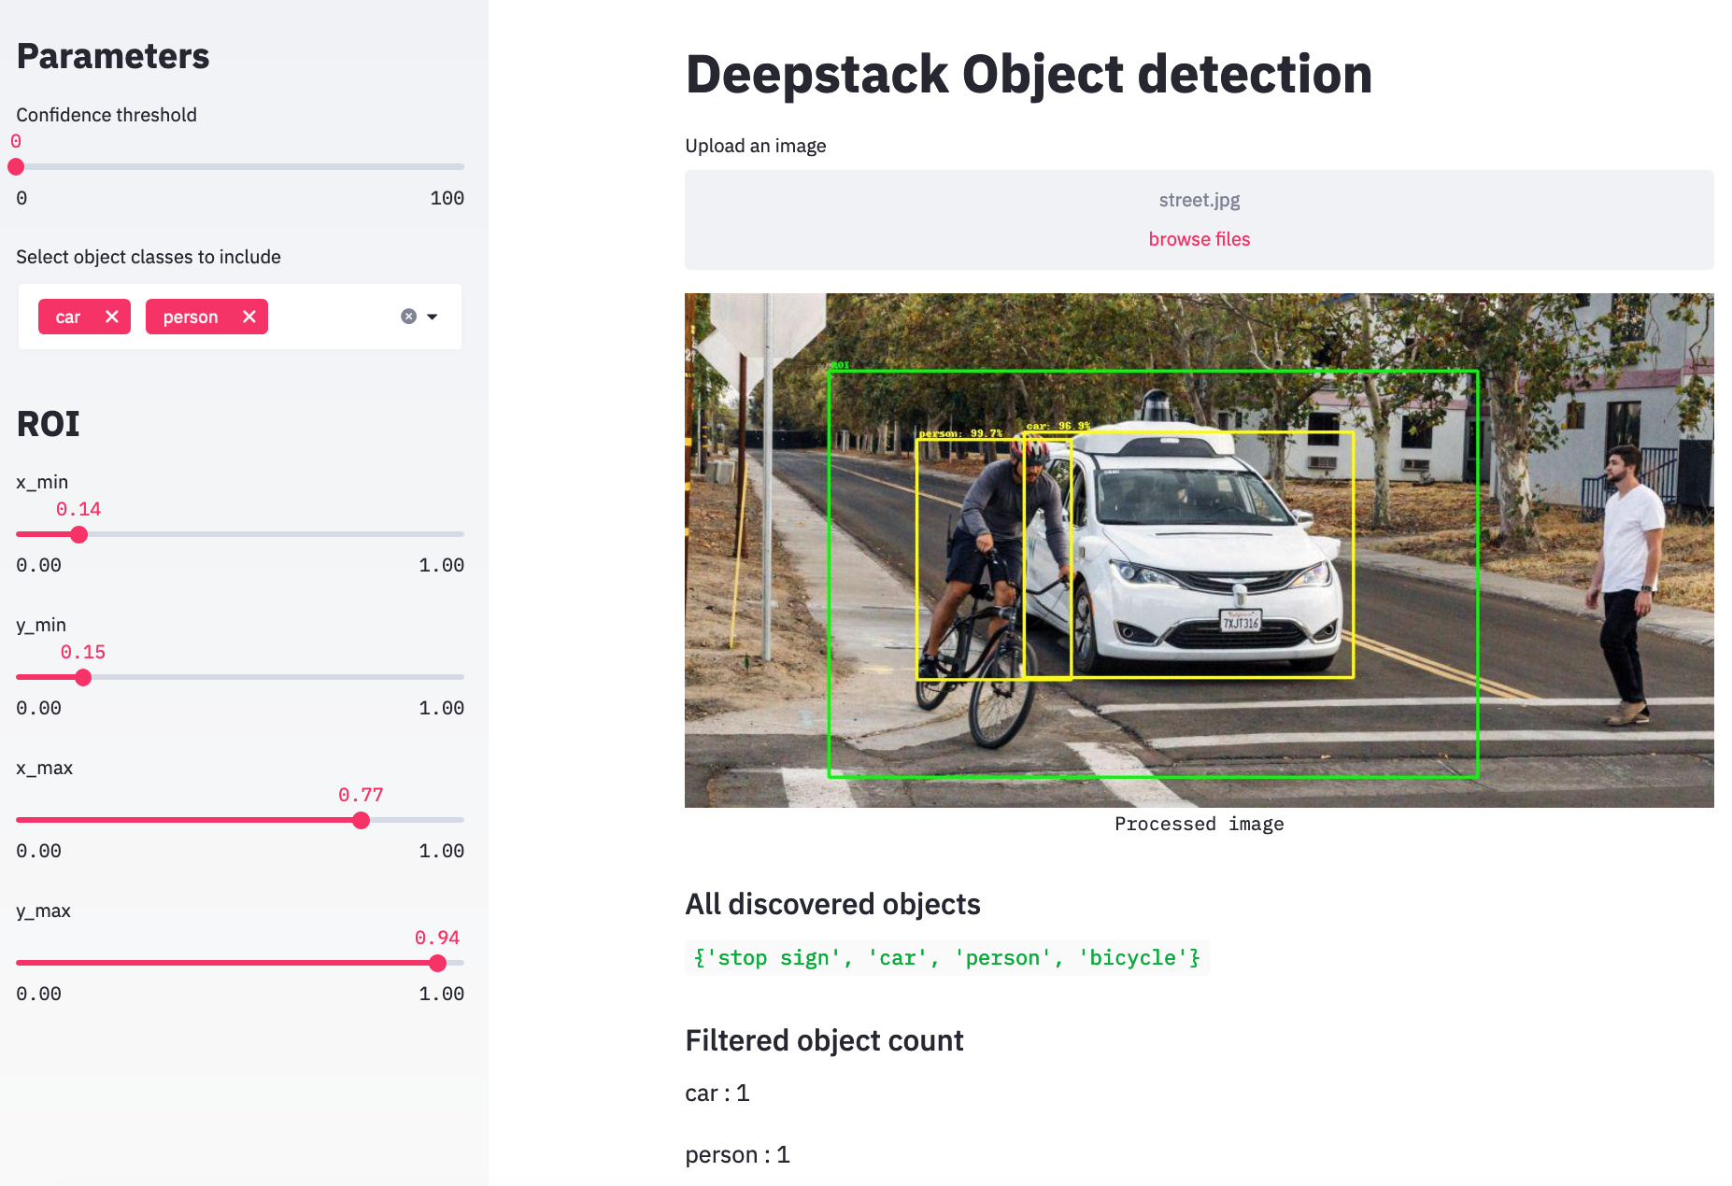


DEPLOYMENT
Streamlit Application
Interactive Input
Upload images or use real-time webcam feed.
Dual Modes
Switch between Classification & Detection analysis.
Rich Visualization
Bounding boxes, confidence scores, and labels overlay.
TECHNOLOGY STACK
Python
TensorFlow
PyTorch
OpenCV
Streamlit

Slide 15
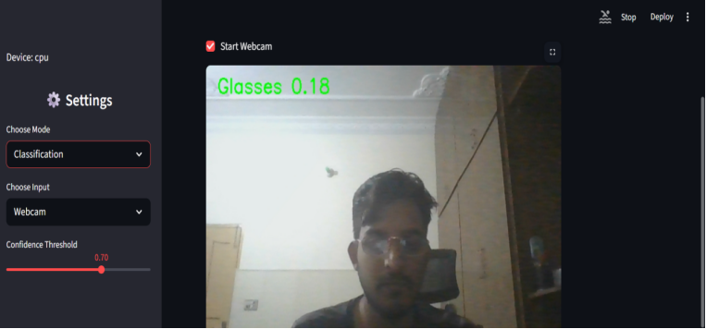
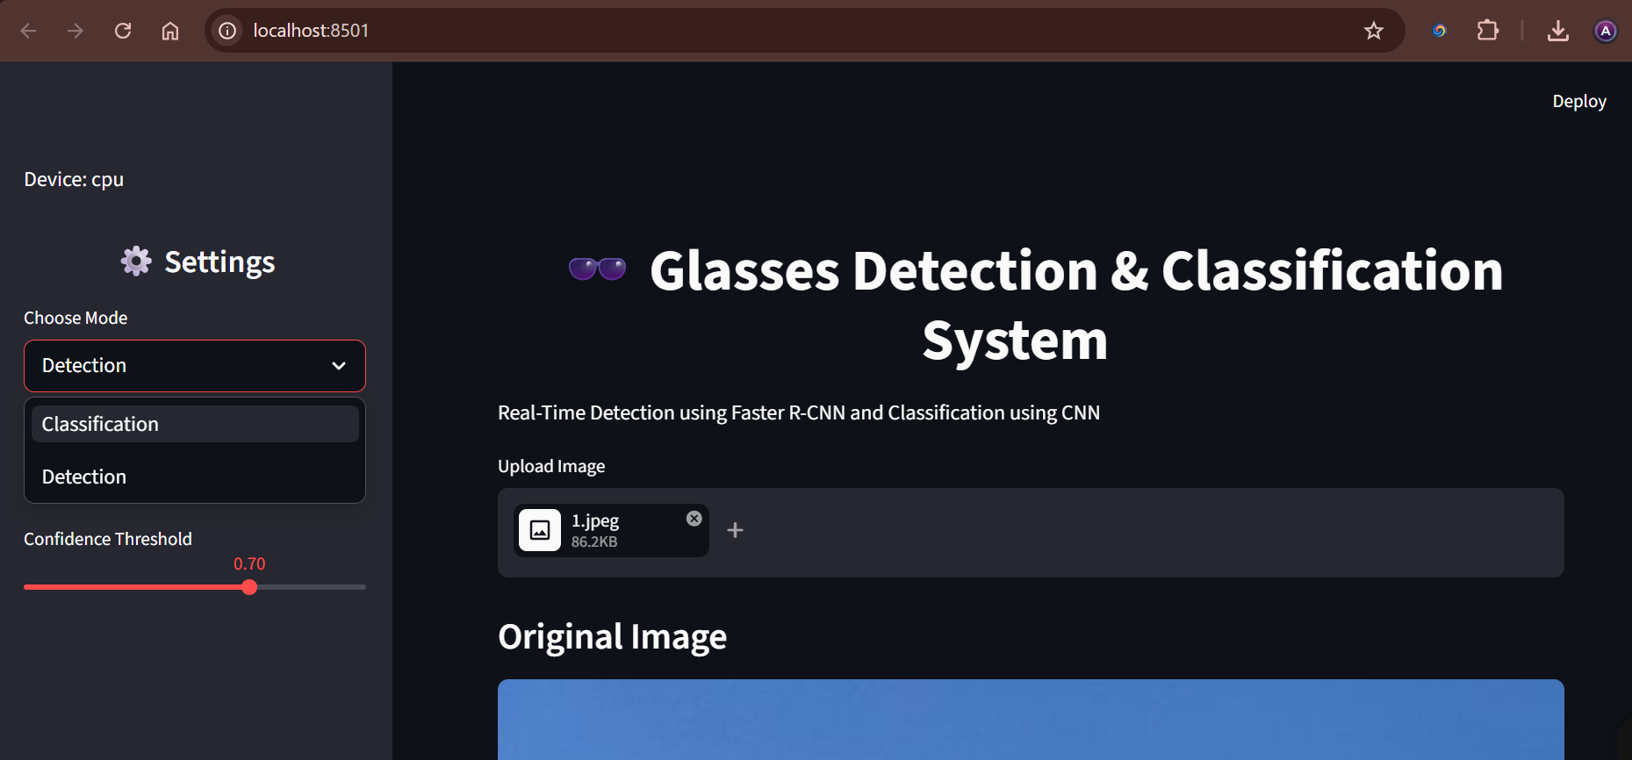





Streamlit Application Demo | Live Interface
Real-Time Classification Mode
Image Upload & Analysis
Classification Mode
Confidence: 0.70
Dual Mode Selection
Upload & Classify
Glasses Detection
Real-Time Processing

Slide 16




Q & A
Thank you for your attention
PRESENTED BY
REGISTRATION NO
COURSE
Wahab Ul Hassan
42-FET/BSCE/F22
Neural Networks

